Slide 1


SMART INDIA HACKATHON 2025
🔗 Blockchain-Based Blue Carbon Registry and MRV System 🌱
“Transparent Blue Carbon Credit System powered by Blockchain + IoT”
Problem Statement ID – 25038.
Problem Statement Title – Blockchain-Based Blue Carbon Registry and MRV System.
Theme – Clean & Green Technology.
PS Category – Software.
Team Name – HEXA VISION

Slide 2

Blockchain-Based Blue Carbon Registry & MRV Platform
HEXA
VISION
Problems :
⚠️ Lack of transparency – in carbon credit tracking
⏳ Slow verification – for blue carbon projects (mangroves , seagrass , salt marshes)
🌱 Difficult for authorities – to authenticate local initiatives
❖ Proposed Solution / Idea :
🔗Blockchain platform – for blue carbon credit tracking
🤖Smart contracts – Automatic tokenization
📱Mobile app + Drones + IoT – real-time data capture
📊 Admin dashboard – for authority verification
Center Visual Flow Diagram :
🌐 Drone/IoT
↓
🔗 Blockchain
↓
📊 Dashboard
↓
💳 Carbon Credits

Slide 3
TECHNICAL APPROACH
HEXA
VISION
TECHNOLOGIES : Blockchain : Hyperledger / Ethereum. Smart Contracts : Solidity Mobile App : Flutter / React Native Dashboard : React + Node.js Cloud DB : AWS / Azure IoT | METHODOLOGY FLOW : Data Capture Smart Contract Validation Token Generation Authority Verification Carbon Credit Issuance
: Drones + Sensors

Slide 4
FEASIBILITY AND VIABILITY
HEXA
VISION
FEASIBILITY✅ : Proven tech: Blockchain + IoT. Scalable across coastal states. Offline data sync. Govt partnerships & phased rollout. Open-source tools to reduce cost. | VIABILITY🌍 : 🌐 Integrates with national carbon credit system. 🏭 High industry demand ensures adoption. 📍 Pilot-ready in coastal states. 👥 Low-cost via community monitoring.

Slide 5
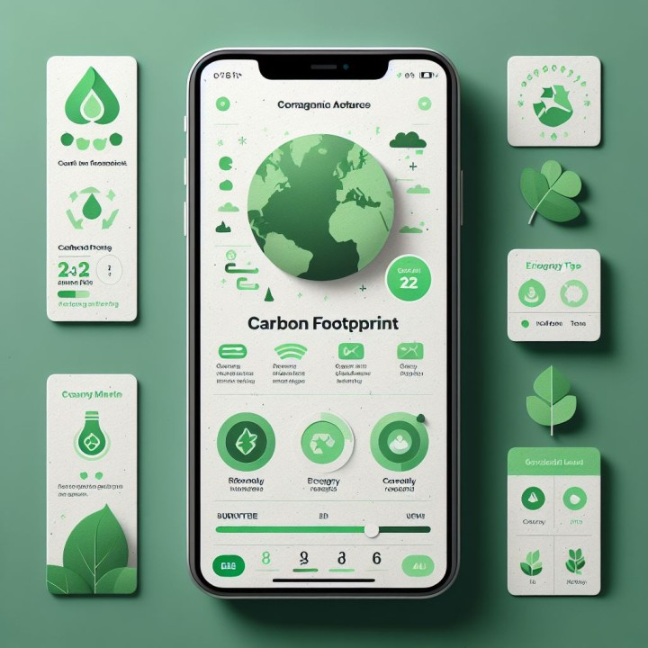
IMPACT AND BENEFITS
HEXA
VISION
1. Environmental Benefits 🌱: Restores mangroves, seagrass & salt marshes Boosts carbon sequestration capacity Helps meet India’s climate targets 2. Economic Benefits 💰: Generates verified carbon credits for industries Attracts green investments Strengthens carbon trading ecosystem 3.Social Benefits 👥: Creates jobs for coastal communities Empowers locals via community monitoring Enhances climate awareness

Slide 6
RESEARCH AND REFERENCES
HEXA VISION
📚 UN Blue Carbon Reports – Global guidelines on coastal ecosystems
🌐 Govt of India – MoEFCC Guidelines – National framework for carbon credits
📄 World Bank – Blockchain in Carbon Markets – Use of emerging tech for climate action
📝 Key Research Papers – Blue carbon restoration & verification models

